Slide 1

Presentation
On
" COVID-19 Situation in Bangladesh: A Comprehensive Analysis "
Instructed By
Name: Dr. Tania Islam
Assistant Professor
Department of Computer Science and Engineering
University of Barishal
Submitted By
Name: Nazmul Hassan
Roll: 01-047-14
Batch – 47
Department of Bangla
University of Barishal
EDGE: BU-CSE Digital Skills Training
Computer Fundamentals & Office Application

Slide 2
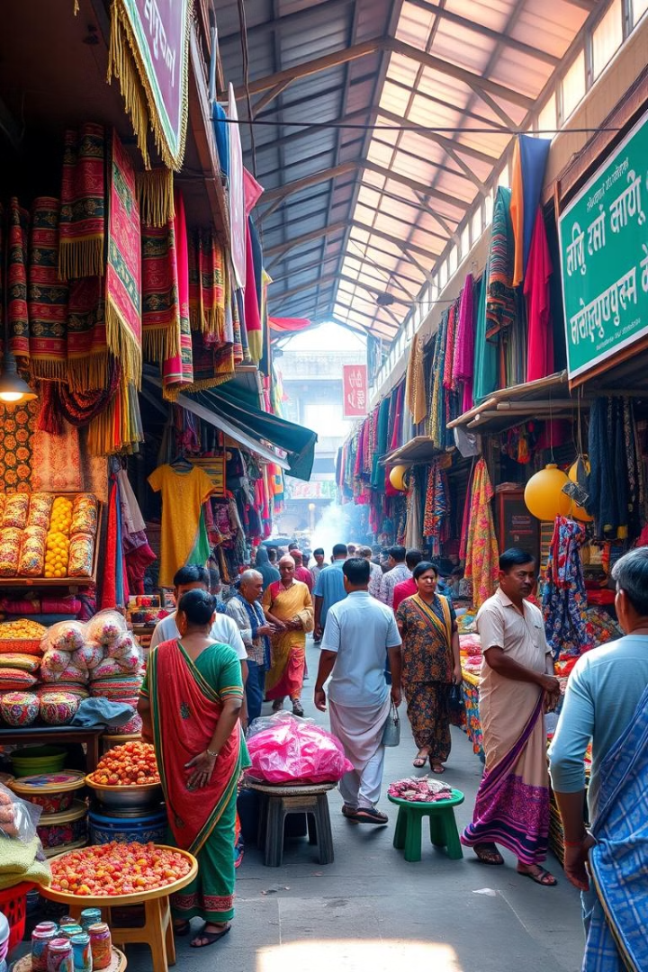
COVID-19 in Bangladesh: A Comprehensive Analysis
This presentation examines the impact of COVID-19 in Bangladesh, highlighting the timeline of events, public health response, socioeconomic consequences, and vaccination progress.
By Nazmul Hassan

Slide 3
Introduction: Understanding the Pandemic's Impact
Global Spread
Initial Response
Public Health Focus
COVID-19, originating in China, spread rapidly across the globe, affecting Bangladesh in early 2020.
The government swiftly implemented lockdowns, travel restrictions, and social distancing measures to control the spread of the virus.
The pandemic put a strain on Bangladesh's public health system, revealing existing infrastructure challenges and highlighting the need for preparedness.

Slide 4

Timeline of COVID-19 in Bangladesh
1
2
3
March 2020
April 2020
January 2021
The first confirmed case was reported in Bangladesh, marking the beginning of the pandemic in the country.
A nationwide lockdown was implemented, restricting movement and gatherings to curb virus transmission.
Bangladesh launched its vaccination program, prioritizing healthcare workers and vulnerable populations.

Slide 5

Public Health Response and Measures
Contact Tracing
Quarantine & Isolation
Bangladesh implemented robust contact tracing efforts to identify and isolate infected individuals to prevent further spread.
Strict quarantine and isolation measures were enforced for confirmed cases and their close contacts.
Public Awareness Campaigns
The government launched public awareness campaigns to educate the population about COVID-19 prevention measures.

Slide 6



Socioeconomic Consequences and Challenges
Economic Downturn
1
The pandemic caused an economic downturn, affecting various industries, particularly the tourism and garment sectors.
Job Losses
2
Many businesses had to shut down, leading to widespread job losses and unemployment.
Poverty Increase
3
The pandemic exacerbated existing poverty levels, with vulnerable populations bearing the brunt of the economic impact.

Slide 7

Vaccination Rollout and Inoculation Progress
185M
Doses Administered
As of late 2023, Bangladesh has administered over 185 million COVID-19 vaccine doses.
85%
Population Coverage
The vaccination program has achieved significant population coverage, helping to curb the spread of the virus.
90%
Healthcare Workers
Almost all healthcare workers have been fully vaccinated, protecting them from infection and ensuring continued care for patients.

Slide 8




Lessons Learned and Recommendations
Invest in Public Health
Strengthening public health infrastructure and healthcare systems is essential to mitigate future pandemics.
Promote Vaccination
Sustaining and expanding vaccination efforts remains critical to protect the population from COVID-19 and future variants.
Economic Resilience
Building economic resilience is crucial to buffer against future shocks and support vulnerable populations.

Slide 9

Conclusion: Moving Forward with Resilience
Bangladesh has demonstrated remarkable resilience in its response to the COVID-19 pandemic. The nation's experience provides valuable lessons for navigating future health crises.

